Slide 1
Performance Optimization 101
Gislen Software

Slide 2
What we will cover
Measuring Application and code performance
Little bit about Benchmark.NET
Little bit about Bogus
StringBuilder vs String
Date Time Parsing
Struct vs Class
Is Clean code actually slower ?
Is LINQ actually slower ?
When to use ValueTask instead of Task and save precious memory ?
Span<T>, Read Only Span<T>
Array Pool
Concept of Lowering

Slide 3
Aspects of Performance

Slide 4

A Benchmark is a test that you run to measure how fast your code is..
https://github.com/dotnet/BenchmarkDotNet
https://benchmarkdotnet.org/articles/overview.html
Install-Package BenchmarkDotNet

Slide 5
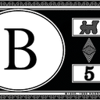
Bogus for .NET
Bogus will help you load databases, UI and apps with fake data for your testing needs
https://github.com/bchavez/Bogus
Install-Package Bogus
For NodeJS people! https://github.com/marak/Faker.js/

Slide 6
Demo

Slide 7
StringBuilder vs String

Slide 8
Date Time Parser

Slide 9
Struct Vs Class
structs have several benefits when it comes to deallocation:
When structs are not part of a class, they are allocated on the Stack and don’t require garbage collection at all (stack unwinding).
Structs take less memory than a reference type because they don’t have an ObjectHeader and a MethodTable.
Full guidelines from Microsoft https://docs.microsoft.com/en-us/dotnet/standard/design-guidelines/choosing-between-class-and-struct

Slide 10
Is Clean code actually slower ?

Slide 11
Is LINQ actually slower ?

Slide 12
When to use Value Task instead of Task and save precious memory ?

Slide 13
Span<T>
System.Memory package built into .NetCore 2.1
Read/write ‘view’ over a contiguous region of memory
Heap (managed objects) – Arrays, Strings
Stack (via stackalloc)
Native / unmanaged
index / iterate to modify the memory within the span
Almost no overhead

Slide 14
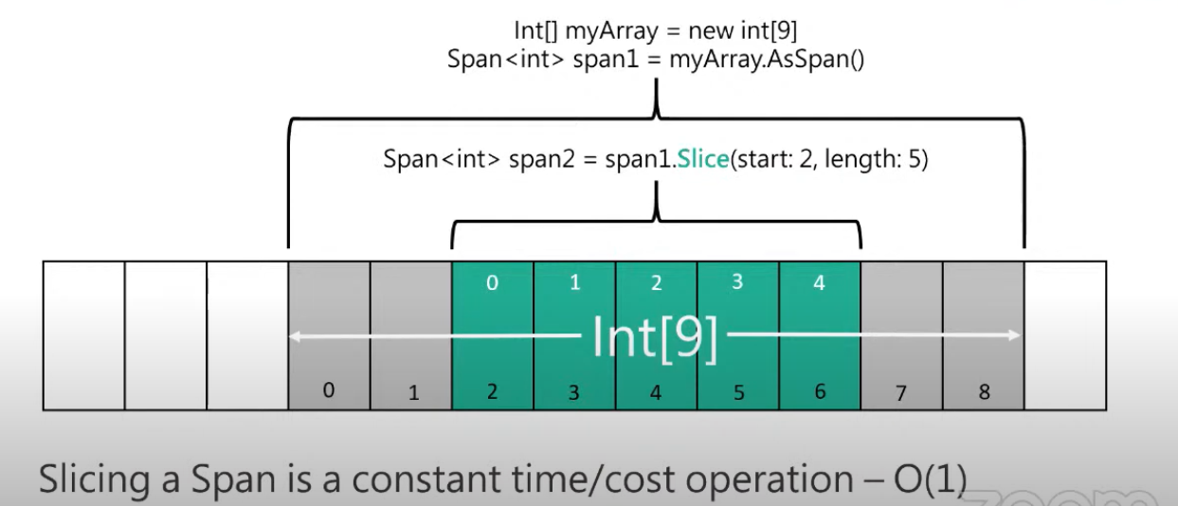
Span<T>

Slide 15
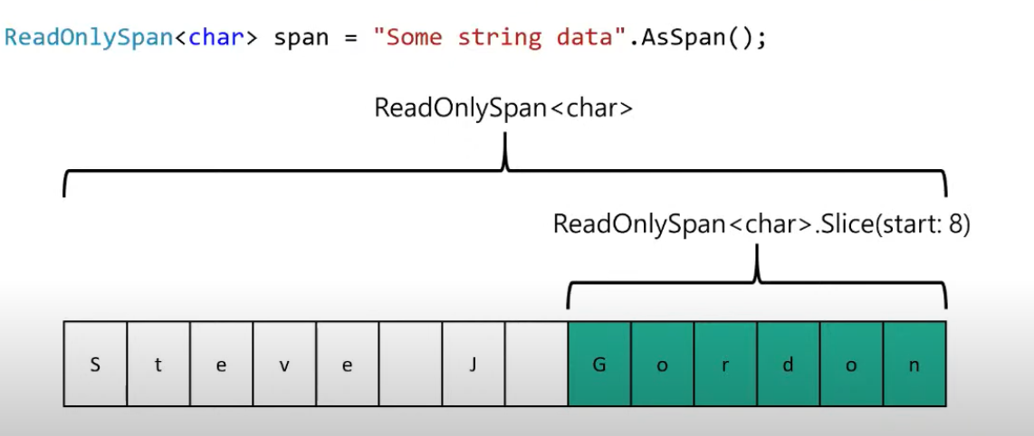
Working with strings

Slide 16
ArrayPool
Pool of array for re-use
Found in System.Buffers.
ArrayPool<T>.Shared.Rent(int length)
You are likely to get an array larger than your minimum size
ArrayPool<T>.Shared.Return(T[] array, bool ClearArray = false)

Slide 17
Lowering
https://sharplab.io/
Loops
Switch
Record
Var keyword
Using Keyword
Async Task

Slide 18
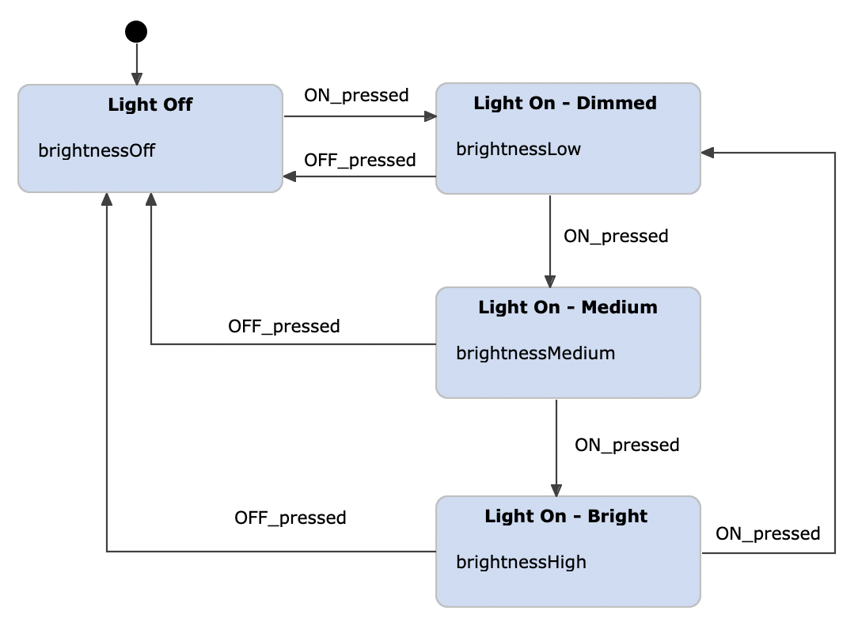
State Machine
https://sharplab.io/

Slide 19
Summary
Measure, don’t assume.
Be scientific
Make small changes each time and measure again
Performance is contextual
Performance should be part of every story
Focus on hot paths
Use StringBuilder for heavy string operations
Use ValueTask
Understand the Pre-compiling phase (lowering)
Avoid LINQ in hot paths
Clean code is always good.
Don’t copy memory, slice it. Span<T> is less complex than it may first seem.
Use ArrayPools where appropriate to reduce array allocations

Slide 20
Thanks for listening
sarathkumarc@Gislen.com

